Slide 1
Open Provenance Model Tutorial
Session 1: Background
Luc Moreau
L.Moreau@ecs.soton.ac.uk
University of Southampton

Slide 2
Session 1: Aims
In this session, you will learn about:
The notion of provenance
The Open Provenance Vision
The Provenance Challenge Series
The birth of OPM

Slide 3
Session 1: Contents
Brief introduction to provenance
The Open Provenance Vision
The Provenance Challenge Series
W3C XG-Prov
Conclusions
Further reading

Slide 4
Provenance 101

Slide 5
Provenance Use Cases
Which doctor was involved in a decision?
Why an organ was rejected for transplant?
Was an organ allocated according to rules?
Was the data used in a manner compatible with the purpose it was captured for?
Was the latest data used in the computation?
Was the data deleted after its use?
Organ Transplant Management
(Vazquez Salceda, Willmott 05-07)
Auditing of private data processing
(Rocio Aldeco Perez 08)
For an extensive catalogue of provenance use cases, see W3C incubator

Slide 6
The Problem
Processes matter
  To validate experimental results
  To reproduce scientific experiments
  To check compliance
  To audit applications
Computers are good at producing results quickly
Computers are bad at explaining their past actions
Is there a principled way of addressing this problem .....

Slide 7
Provenance Definition
Oxford English Dictionary:
  the fact of coming from some particular source or quarter; origin, derivation
  the history or pedigree of a work of art, manuscript, rare book, etc.;
  concretely, a record of the passage
  of an item through its various
  owners.
The provenance of a piece of data is the
process that led to that piece of data

Slide 8
The Open Provenance Vision

Slide 9
Context: heterogeneous environments
Applications consist of compositions of loosely coupled, multi-institutional, heterogeneous components
How to trace the origin of data in such environments?

Slide 10
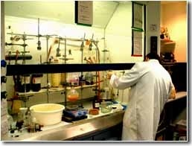
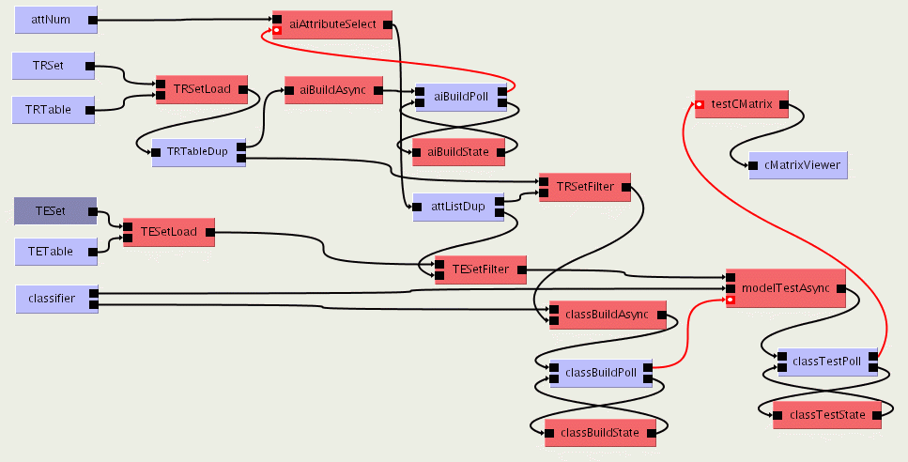
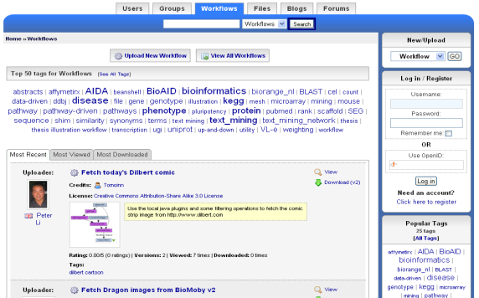

The Science Lifecycle
Virtual Learning Environment
Undergraduate Students
Next Generation Researchers
Digital Libraries
scientists
Graduate Students
Reprints
Peer-Reviewed Journal & Conference Papers
experimentation
Technical Reports
Preprints & Metadata
Local
Web
Data, Metadata, Provenance, Scripts, Workflows, Services,
Ontologies, Blogs, ...
Repositories
Certified Experimental Results & Analyses
Adapted from David De Roure’s
slides

Slide 11
Virtual Learning Environment
Undergraduate Students
Next Generation Researchers
Digital Libraries
scientists
Graduate Students
Reprints
Peer-Reviewed Journal & Conference Papers
experimentation
Finding the Provenance
of research outputs
across all the systems
data transited through
Technical Reports
Preprints & Metadata
Local
Web
Data, Metadata, Provenance, Scripts, Workflows, Services,
Ontologies, Blogs, ...
Repositories
Certified Experimental Results & Analyses

Slide 12

Provenance in a Single Application
Application
data
Feedback (notifications, alarms,
continuous audit)
Record process
assertions
Provenance
Store
Query and reason over
provenance of data

Slide 13
Provenance in a Single Application
We’re becoming good at tracking provenance in a single (monolithic) application
  Provenance in databases (e.g., Perm, Trio, theory)
  Provenance in workflow systems (e.g., Taverna, Kepler, VisTrails)
  Provenance in operating system (e.g., PASS)
  Provenance in some applications (e.g., R, browser)

Slide 14
Provenance Across Applications
Application
Application
Application
Application
Application
How to understand the provenance of data products derived
by all these applications?

Slide 15
Provenance Across Applications
Application
Application
Application
Application
Application
Provenance Inter-Operability Layer
The Open Provenance Model (OPM)

Slide 16
Provenance Inter-Operability Layer

Slide 17
Open Provenance Vision
Open Provenance Vision is a vision of a set of architectural guidelines to support provenance inter-operability, consisting of
  controlled vocabulary,
  serialization formats and
  APIs
Open Provenance Vision allows provenance from individual systems to be expressed, connected in a coherent fashion, and queried seamlessly.

Slide 18
Export/Import Approach(PC3)
PS4
PS2
PS1
PS3
Provenance Inter-Operability Layer
N+1 conversions
Centralisation (scalability, security concerns)
Running queries is easy
Convert PSi content to OPM
Import OPM into PS
Run queries over PS
PS

Slide 19
Distributed Query Approach
PS4
PS2
PS1
PS3
Query API
Query API
Query API
Query API
Offer OPM based Query API
Federated query component
Query API not specified
N query APIs to implement
Running queries is challenging
Better scalability
Federated
Queries

Slide 20
Common Tools
Provenance Inter-Operability Layer
Visualisation
Reasoning
Conversion

Slide 21
Background: Provenance Challenges

Slide 22
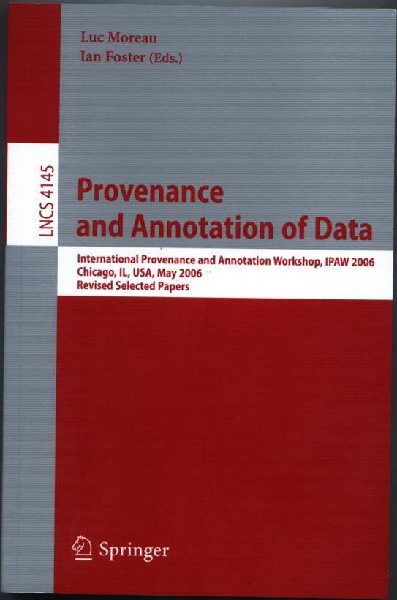

Provenance Challenge 1
Idea came after IPAW’06 standardisation discussion
Set up to be informative rather than competitive
Aims to provide a forum for the community to understand the capabilities of different provenance systems and the expressiveness of their provenance representations

Slide 23
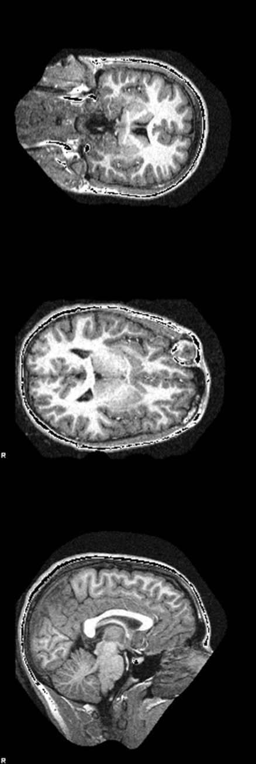
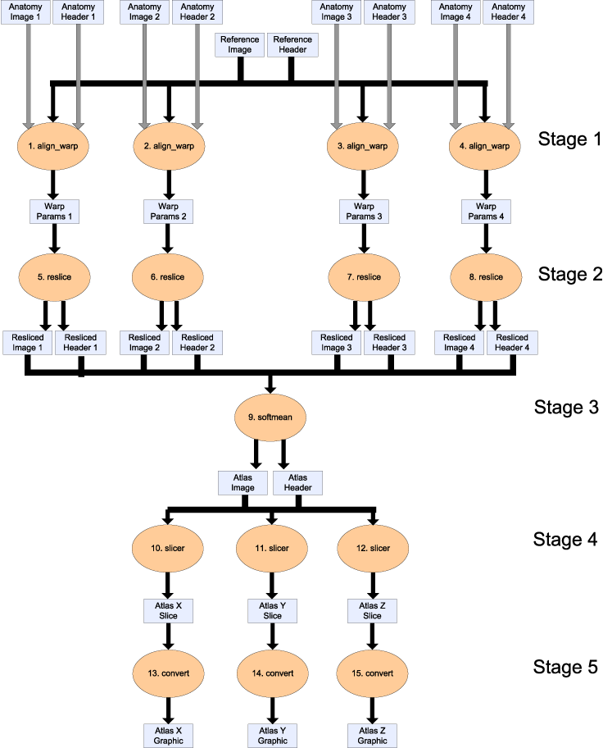
fMRI Workflow

Slide 24
Provenance Questions
Find the process that led to Atlas X Graphic /everything that caused Atlas X Graphic to be as it is.
Find the process that led to Atlas X Graphic, excluding everything prior to the averaging of images with softmean.
Find the Stage 3, 4 and 5 details of the process that led to Atlas X Graphic.
Find all invocations of procedure align_warp using a twelfth order nonlinear 1365 parameter model that ran on a Monday.

Slide 25
Participating Teams
REDUX, MSR
Karma, Indiana U.
myGrid, U. of Manchester
Gridprovenance, Cardiff U.
Zoom, U. of Pennsylvania
DAKS, UC Davis
SDG, PNNL
UChicago, U. of Chicago
USC/ISI, ISI
MINDSWAP, U. of Maryland
JP, CESNET
VisTrails, U. of Utah
ES3, UCSB
RWS, UC Davis and SDSC
PASS, Harvard
NcsaD2k and NcsaCi, NCSA
PASOA, U. of Southampton

Slide 26
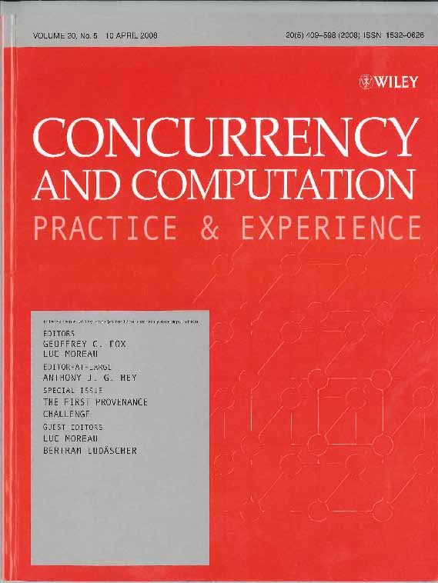
PC1 outcomes
Challenge 1 Provenance questions and expected answers not precise enough
Difficult to validate if results returned are correct or even comparable
Challenge 2 aimed at establishing inter-operability of systems, by exchanging provenance information

Slide 27
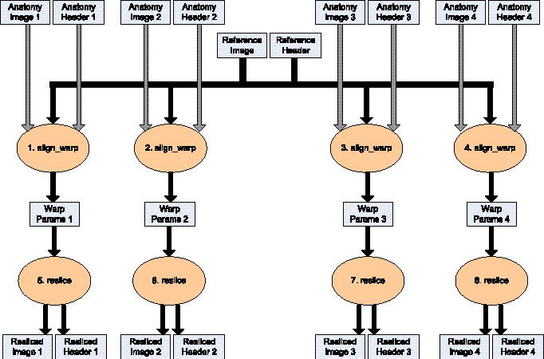
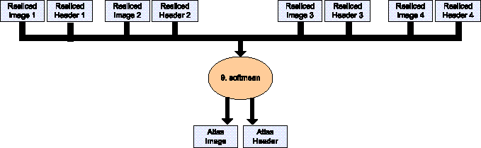
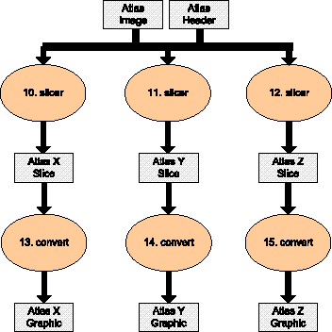
Provenance Challenge 2
Stage 1
Stage 2
Stage 3

Slide 28
Participating Teams
MyGrid U. of Manchester
SDG, PNNL
Karma, Indiana U.
OntoGrid, OntoGrid project
VisTrails, U. of Utah
NCSA, NCSA
ISIwithPASOA, ISI
PASOA, U. of Southampton
MINDSWAP, U. of Maryland
Lineage for JOpera, ETH Zurich
CESNET, CESNET
ES3, UCSB
PASS, Harvard

Slide 29
Outcomes
Differences between “process provenance” and “data provenance” easily bridged
Integrating two or three systems’ provenance data meant interpreting where an identifier produced by one system referred to the same entity as another identifier produced by a different system.
Provenance must, at least, contain a causality graph, i.e. the process that occurred, the derivation of data etc.
It must be an annotated causality graph, in order to capture the details and not just the structure of the provenance.

Slide 30
OPM: the Open Provenance Model
OPM v1.00 (Dec 2007): Luc Moreau, Juliana Freire, Joe Futrelle, Robert E. McGrath, Jim Myers, Patrick Paulson
OPM v1.01 (Jul 2008): Luc Moreau, Beth Plale , Simon Miles, Carole Goble, Paolo Missier, Roger Barga, Yogesh Simmhan, Joe Futrelle, Robert E. McGrath, Jim Myers, Patrick Paulson, Shawn Bowers, Bertram Ludaescher, Natalia Kwasnikowska, Jan Van den Bussche, Tommy Ellkvist, Juliana Freire, Paul Groth

Slide 31
Provenance Challenge 3
Identify weaknesses and strengths of the OPM specification
Encourage the development of concrete bindings for OPM in a variety of languages
Determine how well OPM can represent provenance for a variety of technologies (scientific workflow, databases, etc.)
Demonstrate that a complex data products provenance can be constructed from process assertions produced by multiple combinations of heterogeneous applications
Bring together the community to further discuss the interoperability of provenance systems.

Slide 32
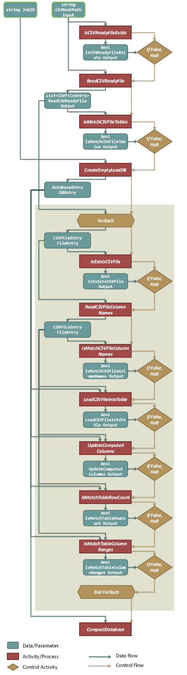
PC3 Workflow
The Pan-STARRS project is building and operating the next generation sky survey
The load workflow PC3, appearing at the handoff between the image pipeline and the object data management, ingests incoming CSV files into a SQL database.

Slide 33
PC3 Objectives
Implement Load workflow
Implement queries:
  For a given detection, which CSV files contributed to it?
  The user considers a table to contain values they do not expect. Was the range check (IsMatchTableColumnRanges) performed for this table?
Export provenance to OPM
Import other teams OPM outputs
Run queries over other teams’ provenance

Slide 34
Participating Teams
NCSA National Center for Supercomputing Applications
Swift, U. Chicago
Trident, Microsoft Research
UCDGC, UC Davis Genome Center
SotonUSCISIPc3 University of Southampton and USC/ISI
UCSBtake3, University of California, Santa Barbara
UoM University of Manchester, UK
TetherlessPC3, Rensselaer Polytechnic Institute/Tetherless World Constellation
UvA/VL-e University of Amsterdam, NL
SDSCPc3 San Diego Supercomputer Center
VisTrails3 University of Utah
KCL, King's College London
PASS3, Harvard
Karma3, Indiana University
UTEP, University of Texas at El Paso

Slide 35
Outcomes
Open source governance model for OPM
Promotion of “profiles” to specialize OPM to specific application domains
Towards OPM1.1, allowing us to achieve the desired inter-operability for PC3
PC4 ... Less workflow centric ... Focusing more on retrieving/querying the provenance of data produced by several systems

Slide 36
OPM: the Open Provenance Model
OPM v1.1 (July 2010): Luc Moreau, Ben Clifford, Juliana Freire, Joe Futrelle, Yolanda Gil, Paul Groth, Natalia Kwasnikowska, Simon Miles, Paolo Missier, Jim Myers, Beth Plale, Yogesh Simmhan, Eric Stephan, and Jan Van den Bussche.

Slide 37
W3C Incubator on Provenance

Slide 38
Provenance Challenge 4

Slide 39
Open Provenance Model
Issued from a community effort
Open source governance model
Exploited by teams in the Provenance Challenge Series
Being used, studied and adopted beyond …
… but what is OPM? … meet us in Session 2!

