Slide 1
Open Provenance Model Tutorial
Session 2: OPM Overview and Semantics
Luc Moreau
L.Moreau@ecs.soton.ac.uk
University of Southampton

Slide 2
Session 2: Aims
In this session, you will learn about:
The Open Provenance Model
The definition of its abstract model
The inferences it supports
Various efforts to provide OPM with a semantics

Slide 3
Session 2: Contents
Requirements and non-requirements
Definition of OPM
Specialization of OPM with Profiles
Formalizations of OPM

Slide 4
OPM (non-)Requirements

Slide 5
OPM Requirements
To allow provenance information to be exchanged between systems, by means of a compatibility layer based on a shared provenance model.
To allow developers to build and share tools that operate on such provenance model.
To define the model in a precise, technology-agnostic manner.
To define bindings to XML/RDF separately
To support a digital representation of provenance for any “thing”, whether produced by computer systems or not

Slide 6
OPM Non-Requirements
OPM does not specify the internal representations that systems have to adopt to store and manipulate provenance internally.
OPM does not specify protocols to store such provenance information in provenance repositories.
OPM does not specify protocols to query provenance repositories.

Slide 7
OPM Layered Model
OPM Domain Specialization: Workflow, Web
Technology Bindings: XML, RDF
OPM Essential Profiles: Collections, Attribution
OPM based APIs: record, query
OPM Core
OPM Sig
Notes:
There is some structure behind OPM, and to understand where we go, we need to understand the structure
At the lowest level, the Core OPM model, with the constructs I identified here.
I also anticipate that OPM must specific what signatures are
Some guidelines are also needed to make it a useful model, in terms of collections and attribution
Separately, we need to serialize OPM (so called technology bindings). Currently, we have two proposals for XML and RDF, but others are interesting such as JSON
It then needs to be specialized for domain specific uses. Two important ones: workflow and the Web
Finally, if you believe in the Open Provenance Vision, there are other questions:
How do we assert and record provenance?
How do we query it?
APIs a required for this.

Slide 8
The Open Provenance Model (OPM)

Slide 9
Open Provenance Model
Allow us to express all the causes of an item
  e.g., provenance of a bottle of wine includes:
    Grapes from which it is made
    Where those grapes grew
    Process in the wine’s preparation
    How the wine was stored
    Between which parties the wine was transported, e.g. producer to distributer to retailer
    Where it was auctioned
Allow for process-oriented and dataflow oriented views
Based on a notion of annotated causality graph

Slide 10
Nodes
Artifact: Immutable piece of state, which may have a physical embodiment in a physical object, or a digital representation in a computer system.
Process: Action or series of actions performed on or caused by artifacts, and resulting in new artifacts.
Agent: Contextual entity acting as a catalyst of a process, enabling, facilitating, controlling, affecting its execution.
A
P
Ag

Slide 11
Edges
A
P
used(R)
P1
P2
wasTriggeredBy
P
wasGeneratedBy(R)
A
A1
wasDerivedFrom
A2
Ag
P
wasControlledBy(R)
Edge labels are in the past to express that these are used to describe past executions

Slide 12
Illustration
A1
A2
Process “used” artifacts and “generated” artifact
Edge “roles” indicate the function of the artifact with respect to the process (akin to function parameters)
Edges and nodes can be typed
Causation chain:
P was caused by A1 and A2
A3 and A4 were caused by P
Does it mean that A3 and A4 were caused by A1 and A2?
used(dividend)
used(divisor)
P
type=division
wasGeneratedBy(quotient)
wasGeneratedBy(rest)
A3
A4

Slide 13
Hierarchical Descriptions (1)
A1
A2
used(r1)
used(r2)
P
wasGeneratedBy(r4)
wasGeneratedBy(r3)
A3
A4

Slide 14
Hierarchical Descriptions (2)
A1
A2
used(r1)
used(r2)
Drill down
P1
P2
wasGeneratedBy(r4)
wasGeneratedBy(r3)
A3
A4

Slide 15
Hierarchical Descriptions (3)
A1
A2
A1
A2
used(r1)
used(r2)
used(r1)
used(r2)
P
P1
P2
wasGeneratedBy(r4)
wasGeneratedBy(r3)
wasGeneratedBy(r4)
wasGeneratedBy(r3)
A3
A4
A3
A4
If these two graphs denote the same execution, it is not true that A4 was caused by A1; hence
dependencies between artifacts need to be asserted explicit

Slide 16
Explicit Data Derivations (1)
A1
A2
A1
A2
used(r1)
used(r2)
used(r1)
used(r2)
wasDerivedFrom
P
wasDerivedFrom
wasDerivedFrom
P1
P2
wasDerivedFrom
wasGeneratedBy(r4)
wasGeneratedBy(r3)
wasGeneratedBy(r4)
wasGeneratedBy(r3)
A3
A4
A3
A4
If these two graphs denote the same execution, it is not true that A4 was cause by A1; hence
dependencies between artifacts need to be asserted explicit

Slide 17
Explicit Data Derivations (2)
A1
A2
Causation chain:
P was caused by A1 and A2
A3 and A4 were caused by P
A3 was caused by A1 and A2
A4 was caused by A1 and A2
used(dividend)
used(divisor)
wasDerivedFrom
P
wasDerivedFrom
wasDerivedFrom
wasDerivedFrom
type
=division
wasGeneratedBy(quotient)
wasGeneratedBy(rest)
A3
A4

Slide 18
Provenance of Physical Objects

Slide 19
Another Account of a same Execution

Slide 20
Accounts
Mechanism by which multiple descriptions of a same execution can co-exist in a same OPM graph
Different accounts may be provided by different observers (or asserters)
Accounts can overlap if they have some OPM subgraph in common
An account can be a refinement of another, if it provides more details
  Support for hierarchical descriptions
Accounts may be conflicting!

Slide 21
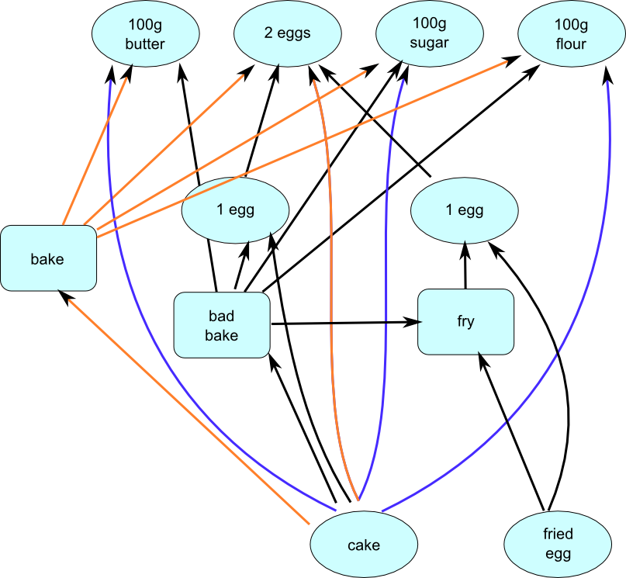
Accounts
Account is like a graph colouring
Nodes/edges are asserted to belong to some accounts
Bake execution
Bad Bake execution
Both executions

Slide 22
OPM Semantics

Slide 23
Completion Rules
P1
P1
A1
A1
A
P
A2
A2
P2
P2
Converse does not
necessarily hold
Equivalence

Slide 24
Inferences
Transitivity of edges connecting an artifact
Starred edge “was Caused by”
What we can infer is defined by transitive closure
A
A
A/P1
A/P1
A
*
A
A
A/P2
A/P2

Slide 25
WasTriggeredBy is not transitive
By completion, there exists A12 generated by P1 and used by P2
By completion, there exists A23 generated by P2 and used by P3
A23 could have been generated before A12 was used
P1
P1
P2
*
P3
P3

Slide 26
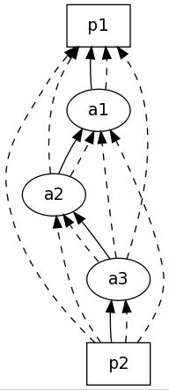
OPM Inferences

Slide 27
Valid OPM Graphs
WasDerivedFrom* is acyclic within one account
  Intuition: a data item cannot be derived from itself
  Note: cycles may exist in multiple accounts
An artifact can be generated by at most one process in a given account

Slide 28
Time Information
Causality implies time ordering, but not the converse
Time regarded as crucial information in the provenance of data (though time does not imply causality)
The model specifies constraints that time information must satisfy with respect to causal dependencies

Slide 29
Time Constraints
Ag
start: T2
end: T5
wasControlledBy(R)
A
P
A
wasGeneratedBy(R)
used(R)
wasGeneratedBy(R)
used(R)
T1
T3
T4
T6
T1<T3 (artifact must exist before being used)
T2<T3 (process must have started before using artifacts)
T3<T5 (process uses artifacts before it ends)
T2<T4 (process must have started before generating artifacts)
T4<T5 (process generates artifacts before it ends)
T4<T6 (artifact must exist before being used)
T2<T5 (process must have started before ending)
no constraint between t3 and t4

Slide 30
Annotations
Let’s no reinvent the wheel!
All OPM entities (edges, nodes, graphs, accounts can be annotated)
All annotations should be addressable (allowing for annotations of annotations)
Bindings to formalize how annotations can be serialized (standard in RDF, custom in XML)
Reserved properties: hasType, hasValue, ...

Slide 31
OPM SpecialiZations

Slide 32
Concept of a Profile
A specialisation of an OPM graph for a specific domain or to handle a specific problem
Profile definitions are welcome!
Note: profile multiplicity challenges inter-operability
A profile has a unique identity
Defines vocabulary, guidelines, expansion guidance, serialisation format

Slide 33
Profile Compliance
PROFILE
Id
Vocabulary
Guidance
Expansion directives
Serialisation
Profile Expansion
Profile
Compliant
Graph
Profile-expanded
Graph

Slide 34
Profile Compliance
Profile-expanded
Graph
Profile
Compliant
Graph
OPM Inference
Inferred Graph 2
Inferred Graph1

Slide 35
Emerging Profiles
Emerging Profiles
  Collections
  Dublin Core
  D-Profile
Will be discussed in separate session

Slide 36
OPM Formalizations

Slide 37
Early Formalizations
OPM v1.00 and OPMv1.01 contained a set-theoretic definition of OPM and permitted inferences
Moved out of OPMv1.1 since it is difficult to keep specification and formalization in sync
While the formalization is useful in defining OPM precisely, it does not give OPM a meaning!

Slide 38
Reproducibility Semantics
(Moreau 2010)
Sees OPM graph as an executable program:
  Each process is associated with the name of an executable primitive
  Primitive environment maps primitive names to primitives
    PrimitiveEnv = PrimitiveName→Primitive
    Primitive = P(RoleValue) →P(RoleValue)
  Graph factories to create new artifacts, new processes …

Slide 39
Reproducibility Semantics
(Moreau 2010)
An execution of an OPM graph results in
  A new OPM graph, describing re-execution
  A mapping between nodes of the original graph and the resulting graph
Execution proceeds by ordering processes (assumes acyclicity) and re-executing them, one by one; for each process executed, new process node and new output artifacts are created by factory

Slide 40
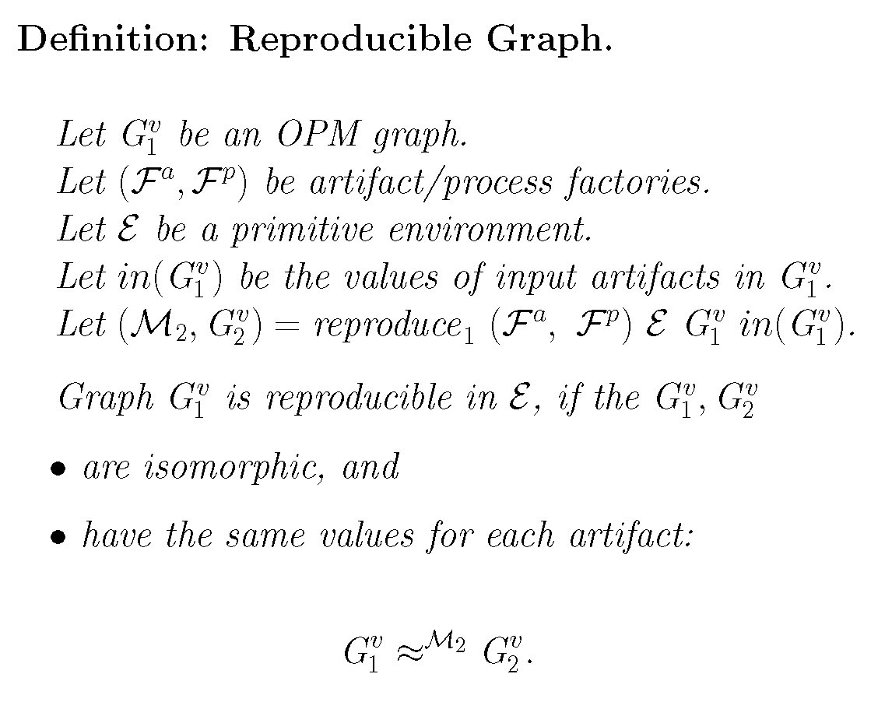
Reproducibility Semantics
(Moreau 2010)

Slide 41
Temporal Semantics
(Kwasnikowska, Moreau, Van den Bussche 2010)
Timepoints
  create(A): creation of artifact A
  begin(P), end(P): beginning and end of process P
  use(P,r,A): use of artifact A in role r, by process P
Temporal theory Th(G) of a graph G is a set of inequalities: e.g.,
  begin(P)≤create(A) for any generated-by edge A→P
  create(A)≤end(P) for any used edge P→A
Temporal interpretation of G is a triple (T, ≤, τ)
A temporal interpretation satisfies u≤v if τ(u) ≤ τ(v)
A temporal model of G is a is a temporal interpretation that satisfies all inequalities from Th(G)
Logical consequence G ⊨ u≤v if it is satisfied in every temporal model of G.

Slide 42
Temporal Semantics
(Kwasnikowska, Moreau, Van den Bussche 2010)
OPM Inference: G ⊢ A→P
Why this set of inference rules?
Characterization of OPM inference rules in the form of a soundness and completeness result
  Cases not involving use-timepoints
  G ⊨ begin(P)≤create(A) iff G ⊢ A→P
  Cases involving use-timepoints
  G ⊨ begin(P)≤use(Q,r,A) iff G ⊢ some pattern

Slide 43
Temporal Semantics
(Kwasnikowska, Moreau, Van den Bussche 2010)
Refinement of two OPM graphs
  Let us consider two OPM graphs G and H,
  For any timepoints u,v of both G and H,
  G is refined by H
  If G ⊨ u≤v then H ⊨ u≤v

Slide 44
Causality Semantics
(Cheney 2010)
Exploits Halpern and Pearl’s causal theory of explanation
The semantics of an OPM graph is a causal function, mapping graph inputs to outputs
Provenance semantics P f approximates locally a function f, if for any u₁, …, u_{n}
[[P f(u₁, …, u_{n})]]_{τ}=f_{τ}(u₁, …, u_{n})
for some intervention τ fixing some inputs of f

Slide 45
Workflow Semantics
(Missier and Goble 2010)
Two functions:
  W2G: Workflow × Trace → OPM Graph
  G2W: OPM Graph → Workflow
Two properties:
  Plausible workflow:
    W2G(G2W(g),T)=g
  Lossless-ness:
    G2W(W2G(w,T))=w
Define W2G and G2W for Taverna workflow language
Introduce annotations to be able to reconstruct Taverna iterations
In essence, provide a semantics for OPM by composing G2W and Taverna semantics

Slide 46
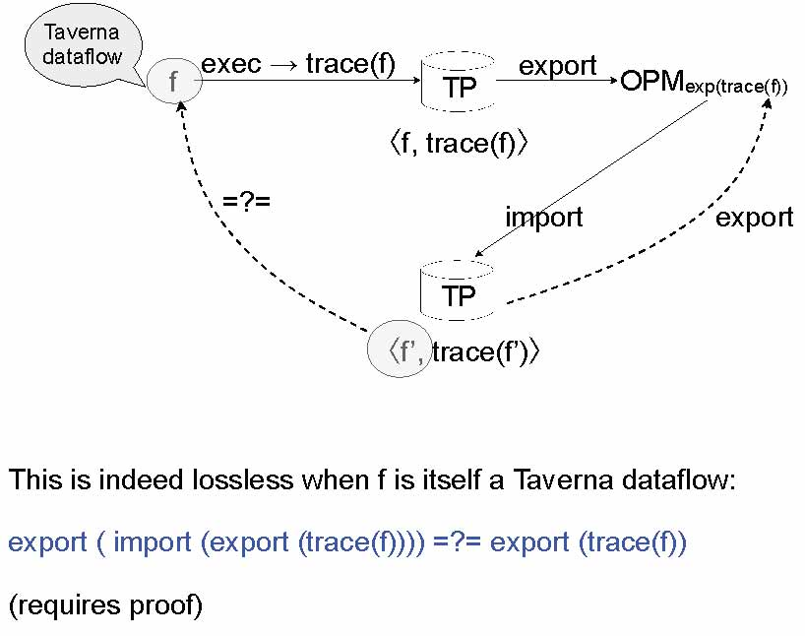
Workflow Semantics
(Missier and Goble 2010)

Slide 47
Provenance Vocabulary Mappings
(Sahoo et al 2010)
OPM selected as the reference provenance model.
First, because OPM is a general and broad model that encompasses many aspects of provenance.
Second, it already represents a community effort that spans several years and is still ongoing, already benefiting from many discussions, practical use, and several versions.
Finally, many groups are already undergoing efforts to map their vocabularies to OPM, and in addition there are already some mappings (called profiles in OPM) developed by the OPM group to some existing vocabularies.

Slide 48
Conclusions on OPM Semantics
Four novel semantics of OPM published in 2010
Deal with different subsets of OPM
Not all fully “compatible” with OPM v1.1
Grand theory of OPM is still an open problem

Slide 49
Conclusion and OPEN ISSUES

Slide 50
Conclusions
Over 14 teams have implemented the OPM specification for a successful inter-operability exercise PC3
Open source governance model for OPM
OPM1.1 published and to be used in PC4
OPM consists of a common core found in many provenance vocabularies
What beyond?
  Define useful profiles
  Finalize semantics

Slide 51
Open Issues (inter-operability)
List of technical issues: agents, annotations, time, streamed data, collections, mutable objects
How to express queries over OPM graphs?
Security: attribution and non-repudiation
API for recording and querying
How to inter-operate in a distributed system?

Slide 52
Open Issues (research)
Accounts
Relations between accounts: refinement, overlap, alternate
Reasoning with conflicting provenance
Reasoning with incomplete provenance
Can we formalise profiles?

