Slide 1
Open Provenance Model Tutorial
Session 4: Use Cases

Slide 2
Session 4: Aims
In this session, you’ll learn about
Exemplar use cases that demonstrate the need for provenance
How to identify and organize provenance issues from a use case
Determine where OPM can help

Slide 3
Session 4: Contents
Motivation
Exercise: your use case
W3C Use Cases & Scenarios
Organizing Requirements
Exercise: situating your use case

Slide 4

A bit of motivation….
Notes:
Click to start in presentation mode… from http://www.youtube.com/watch?v=LVEPdV_warU&feature=youtu.be

Slide 5
Think of a use case…
Think of an application or scenario where provenance is required?
Notes:
Print out some use cases

Slide 6
Some questions…
Why is provenance required?
Where are the difficulties with respect to provenance?
  Technologically?
  Socially?

Slide 7
W3C Incubator Group Use Cases
Result Differences
Anonymous Information
Information Quality Assessment for Linked Data
Timeliness
Simple Trustworthiness Assessment
Ignoring Unreliable Data
Answering user queries that require semantically annotated provenance
Provenance in Biomedicine
Closure of Experimental Metadata
Provenance Tracking in the Blogosphere
Provenance of a Tweet
Provenance and Private Data Use
Provenance of Decision Making in Emergency Response
Provenance of Collections vs Objects in Cultural Heritage
Provenance at different levels in Cultural Heritage
Locating Biospecimens With Sufficient Quality
Identifying attribution and associations
Determining Compliance with a License
Documenting axiom formulation
Evidence for public policy
Evidence for engineering design
Fulfilling Contractual Obligations
Attribution for a versioned document
Provenance for Environmental Marine Data
Crosswalk Maintenance
Metadata Merging
Mapping Digital Rights
Computer Assisted Research
Handling Scientific Measurement Anomaly
Human-Executed Processes
Semantic disambiguation of data provider identity
Hidden Bug
Using process provenance for assessing the quality of Information products
http://www.w3.org/2005/Incubator/prov/wiki/Use_Cases

Slide 8
An Example
Owner
Chris Bizer
(Curator: Satya Sahoo)
Provenance Dimensions
Primary: Attribution (Content), Evolution and versioning (Content)
Secondary: Scale (Management), Law Enforcement (Management), Understanding (Use), Trust (Use), Incomplete provenance (Use)
Background and Current Practice
Within the Blogosphere, topics are discussed across blogs that refer to each other, for example on personal blogs, project weblogs, and on company blogs. The cross references are in the form of links at the bottom of a blog post, hyperlinks within a blog post, and quotation of text from other blogs. Blog posts are also aggregated and republished by services like Technorati, BlogPulse, Tailrank, and BlogScope, that track the interconnections between bloggers. Correct attribution of blogs, as they are processed, aggregated and republished on the Web, is an important requirement in the blogosphere.
Goal
Enable applications on the Web to attribute content from different sources to a specific individual or an organization. In this use case, blogs are an example of content flow between websites, and it is important to trace back republished posts to their original source.
Use Case Scenario
A website X collates Web content from multiple sites on a particular topic that is processed and aggregated for use by its customers. It is imperative for website X to present only credible and trusted content on its site to satisfy its customer, attract new business, and avoid legal issues. In the context of this blogosphere use case, a blog aggregator service or an user wants to identify the author of a blog without violating privacy laws. In some scenarios, the aggregator service or user may have only incomplete attribution information. In case the author of a blog is listed by name (first name, last name), disambiguation of an author is difficult with multiple blog authors sharing the same name and this may require use of additional user information (for example, email address) without violation of user privacy or privacy laws.
Problems and Limitations
The provenance of Web content in general and blog posts in particular are necessary to users for correct attribution and to aggregating services. Aggregating services require provenance information to not only attribute content but also offer additional services such as ranking of popular blog posts.
Technical Challenges:
Enable Trace back and correct attribution without violating user privacy and privacy laws
Disambiguating content authors with incomplete provenance information
Extend existing vocabulary for representing posts, such as SIOC, to model finer granularity provenance information.
Existing Work
The SIOC project has developed a vocabulary for representing posts. This vocabulary is often used together with FOAF (that represent information about the physical person related to a sioc:User, e.g. its name, lastname, phone, social network, etc.) and SKOS, used mainly to represent topics and taxonomy relationships between these topics.

Slide 9
Provenance Dimensions
Three core dimensions:
Content
Management
Use
http://www.w3.org/2005/Incubator/prov/wiki/Provenance_Dimensions
Notes:
Content refers to what types of information would need to be represented in a provenance record
Provenance management refers to the mechanisms that make provenance available and accessible in a system.
Use of any provenance information that we have recorded. The same provenance records may need to accommodate a variety of uses.

Slide 10
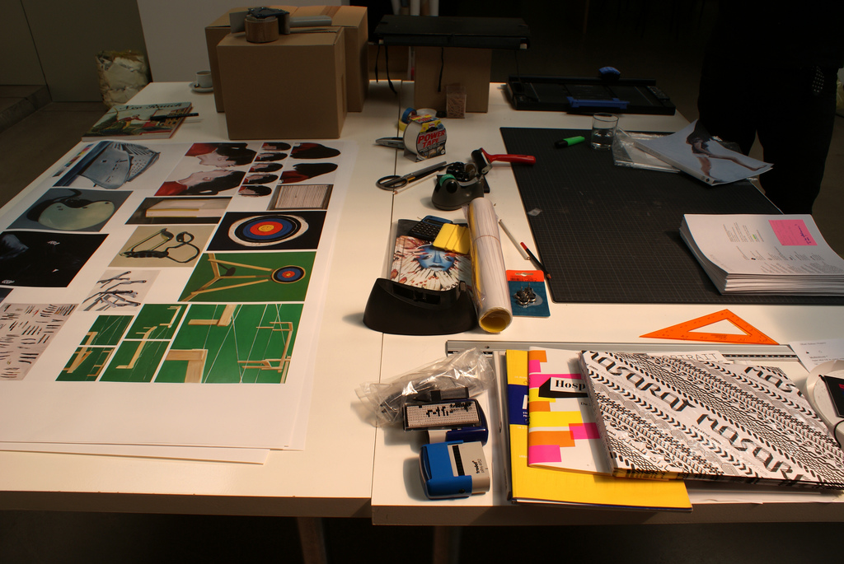
Content:Object
What the provenance is about
?
?
?
From http://www.flickr.com/photos/marcwathieu/2796320178/sizes/z/in/photostream/

Slide 11
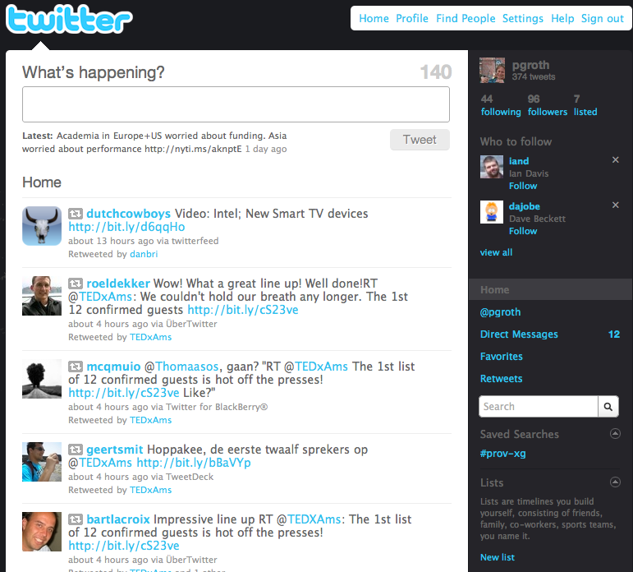
Content: Attribution
Attribution - provenance as the sources or entities that were used
  Responsibility
  Origin
Notes:
Responsibility: knowing who endorses a particular piece of information or result
Origin: recorded vs reconstructed, verified vs non-verified (eg with digital signatures), asserted vs inferred
-- Who can I sue?

Slide 12
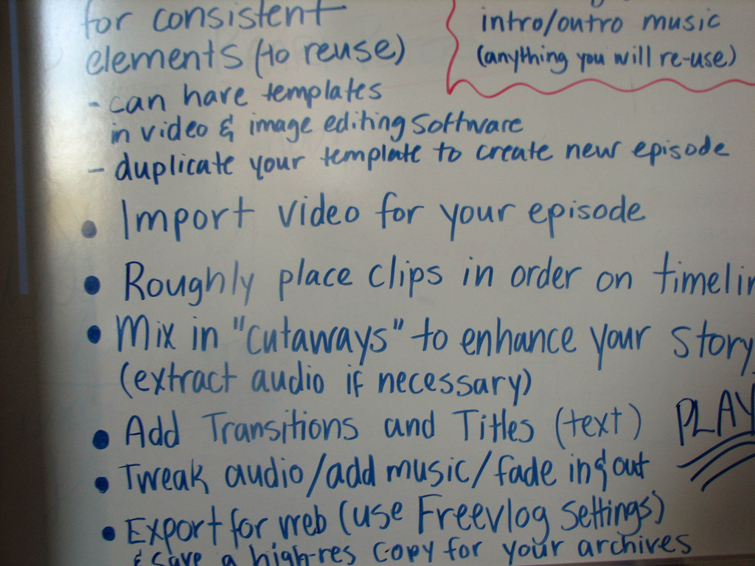
Content: Process
The process that yielded an artifact
  Reproducibility
  Data Access
Evolution
  Versioning
  Republishing
  Updates
From: http://www.flickr.com/photos/darinhercules/1848992438/sizes/l/in/photostream/
Notes:
Reproducibility (eg workflows, mashups, text extraction)
Data Access (e.g. access time, accessed server, party responsible for accessed server)
Republishing (e.g. retweeting, reblogging, republishing)
Updates (eg a document that assembles content from various sources and that changes over time)

Slide 13
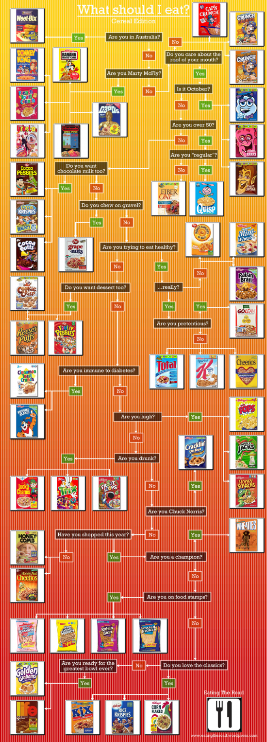
Content: Justification
Capturing why and how a particular decision is made
  Argumentation
  Hypothesis management
  Why-not questions
Notes:
Argumentation - what was considered and debated (eg pros and cons) before reaching a solution
Hypothesis management (complementary/contrary evidence is provided by different sources)
Why-not questions - capturing why a particular choice was not made

Slide 14
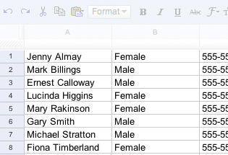
Content
Entailment - given the results to a particular query from a system how did the system produce results
Query: How many females?
Response: 4 Females
Notes:
in a reasoning system or DB, capture how the system produced an answer given what axioms or tuples it contained that led to those results

Slide 15
Management: Publication
Making provenance information available on the web
@prefix opm: <http://openprovenance.org/ontology#> .
@prefix pc1: <http://www.ipaw.info/pc1/> .
pc1:black a opm:Account .
pc1:p1 a opm:Process ;
opm:account pc1:black ;
opm:label "PC1 Workflow" .
pc1:ag1 a opm:Agent ;
opm:account pc1:black ;
opm:label "John Doe" .
pc1:ti_0 a opm:OTime ;
opm:exactlyAt "2010-01-20T12:50:35.999Z"^^<http://www.w3.org/2001/XMLSchema#dateTime> .
pc1:a1 a opm:Artifact ;
opm:account pc1:black ;
opm:label "Anatomy Image1" .
pc1:a2 a opm:Artifact ;
opm:account pc1:black ;
opm:label "Anatomy Header1" .
pc1:a3 a opm:Artifact ;
opm:account pc1:black ;
opm:label "Reference Image" .
pc1:a4 a opm:Artifact ;
opm:account pc1:black ;
opm:label "Reference Header" .
pc1:a5 a opm:Artifact ;
opm:account pc1:black ;
opm:label "Atlas X Graphic" .
pc1:r_81 a opm:Role ;
opm:value "img1" .

Slide 16
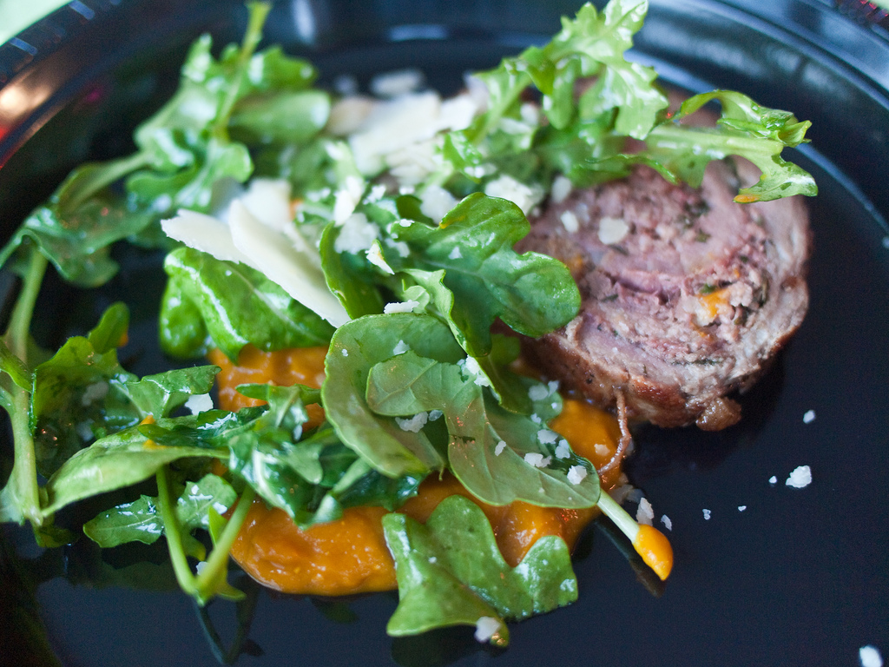
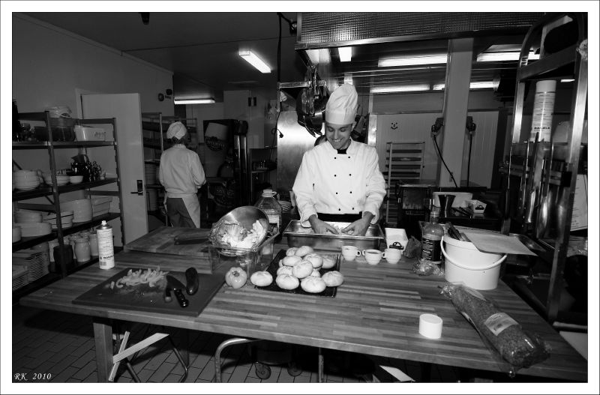
Management: Access
Finding and querying provenance information
What’s the provenance?
http://www.flickr.com/photos/edsel_/4735698862/sizes/l/in/photostream/
From: http://www.flickr.com/photos/expresbro/4685175872/sizes/l/in/photostream/

Slide 17
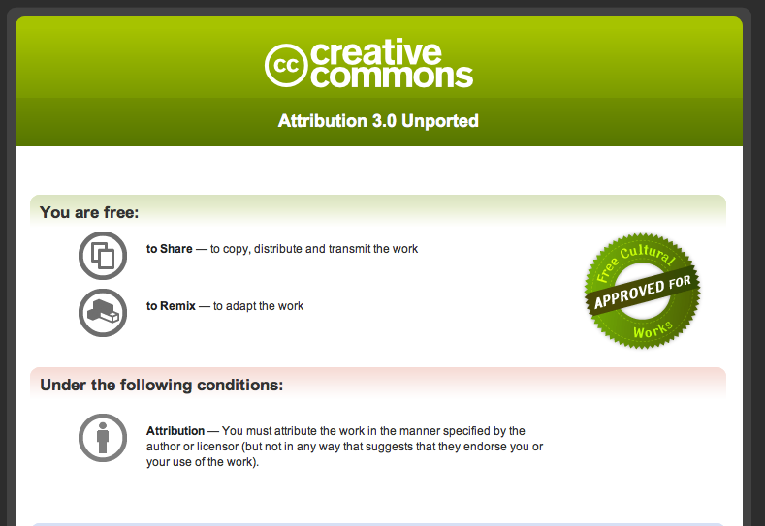
Management: Dissemination
Track the policies for when/how an entity can be used as specified by the creator of that entity
  Access Control
  Licensing
  Law enforcement

Slide 18
Management
Scale - how to operate with large amounts of provenance information

Slide 19
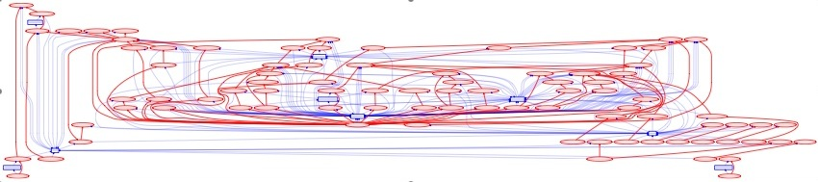
Use: Understanding
End user consumption of provenance
  Presentation
  Abstraction
Notes:
abstraction, multiple levels of description, summary
presentation, visualization

Slide 20
Use: Interoperability
Provenance Inter-Operability Layer
Visualisation
Reasoning
Conversion

Slide 21

Use: Accountability & Trust
Accountability
  Verification
  Compliance
Trust
  Information quality
  Reputation / Reliability
From: http://www.flickr.com/photos/el_ramon/3804532661/
Notes:
Accountability - the ability to check the provenance of an object with respect to some expectation
Verification - of a set of requirements
Compliance - with a set of policies
Information quality - choosing among competing evidence from diverse sources (eg linked data use cases)
Incorporating reputation and reliability ratings with attribution information

Slide 22
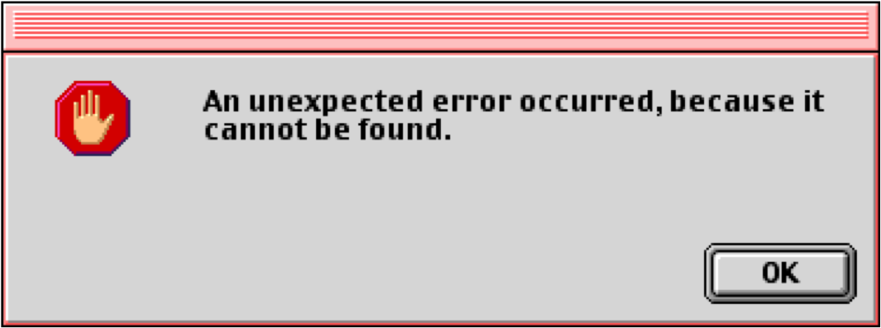
Use: When things go wrong
Imperfections - reasoning about provenance information that is not complete or correct
  Incomplete
  Uncertain
  Erroneous
  Fraudulent
Debugging
Comparison
From: http://www.flickr.com/photos/dullhunk/4517822872/sizes/o/in/photostream/

Slide 23
Applying the Dimensions
3 scenarios from the W3C incubator group
Scenario aggregates from many different use cases

Slide 24

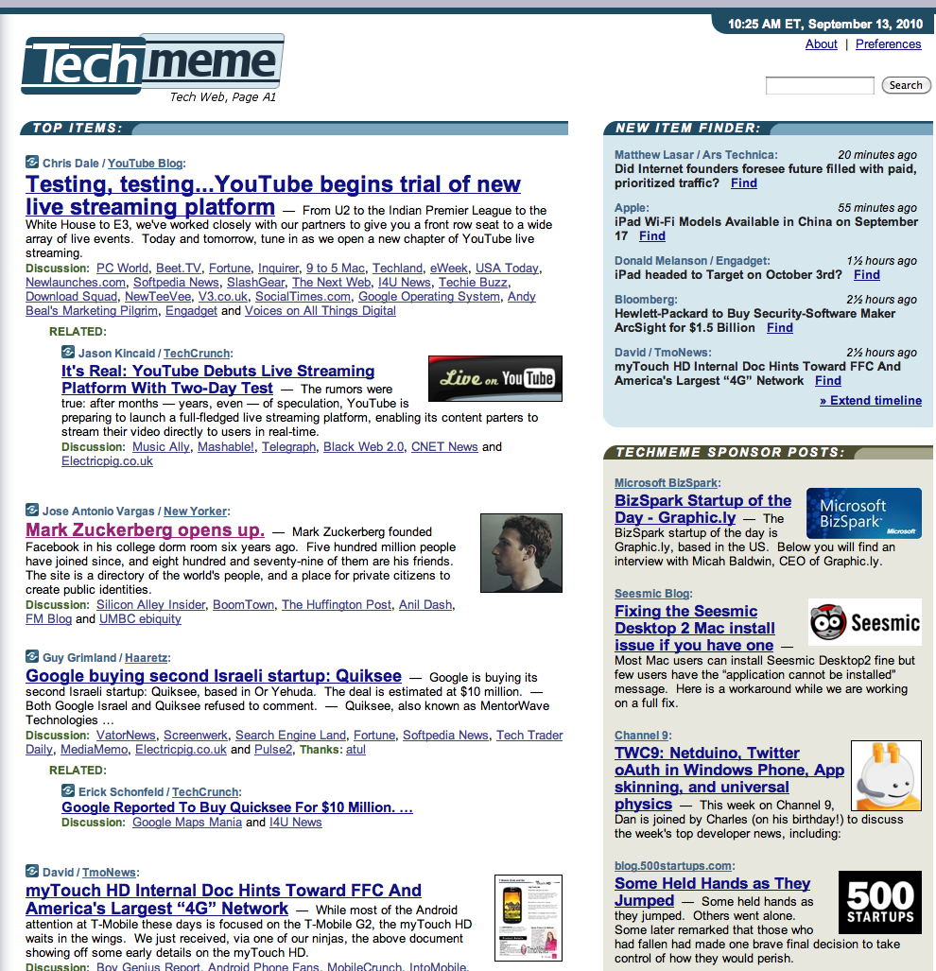
Scenario 1: BlogAgg
Notes:
A news aggregator site that assembles news items from a variety of sources (such as news sites, blogs, and tweets), where provenance records can help with verification, credit, and licensing

Slide 25
Provenance Problem
BlogAgg wants to determine the correct originator of an item
BlogAgg wants to determine if it can reuse an image
BlogAgg wants to determine if the image was modified
BlogAgg want to provide confidence to the end-user

Slide 26
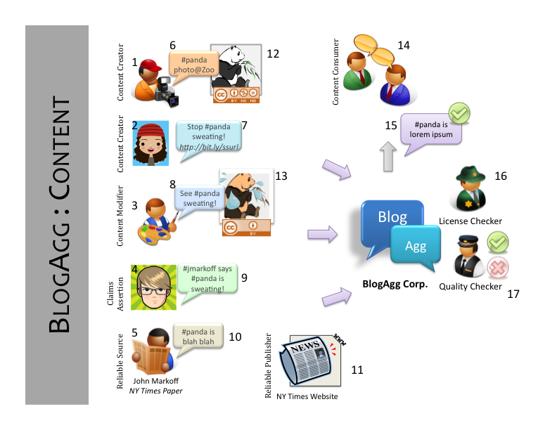

Slide 27
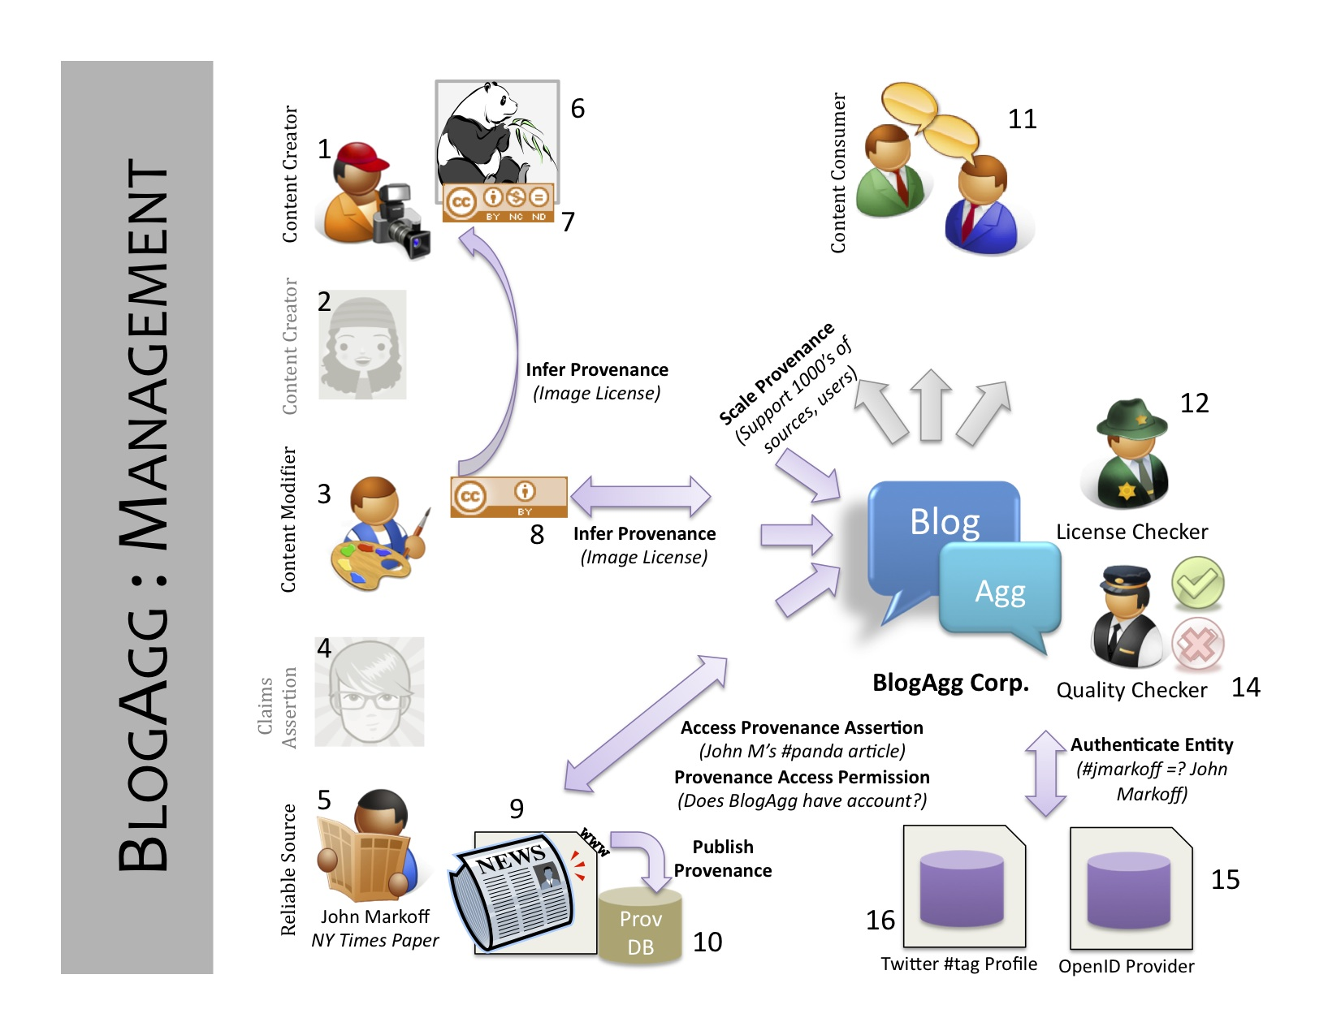

Slide 28
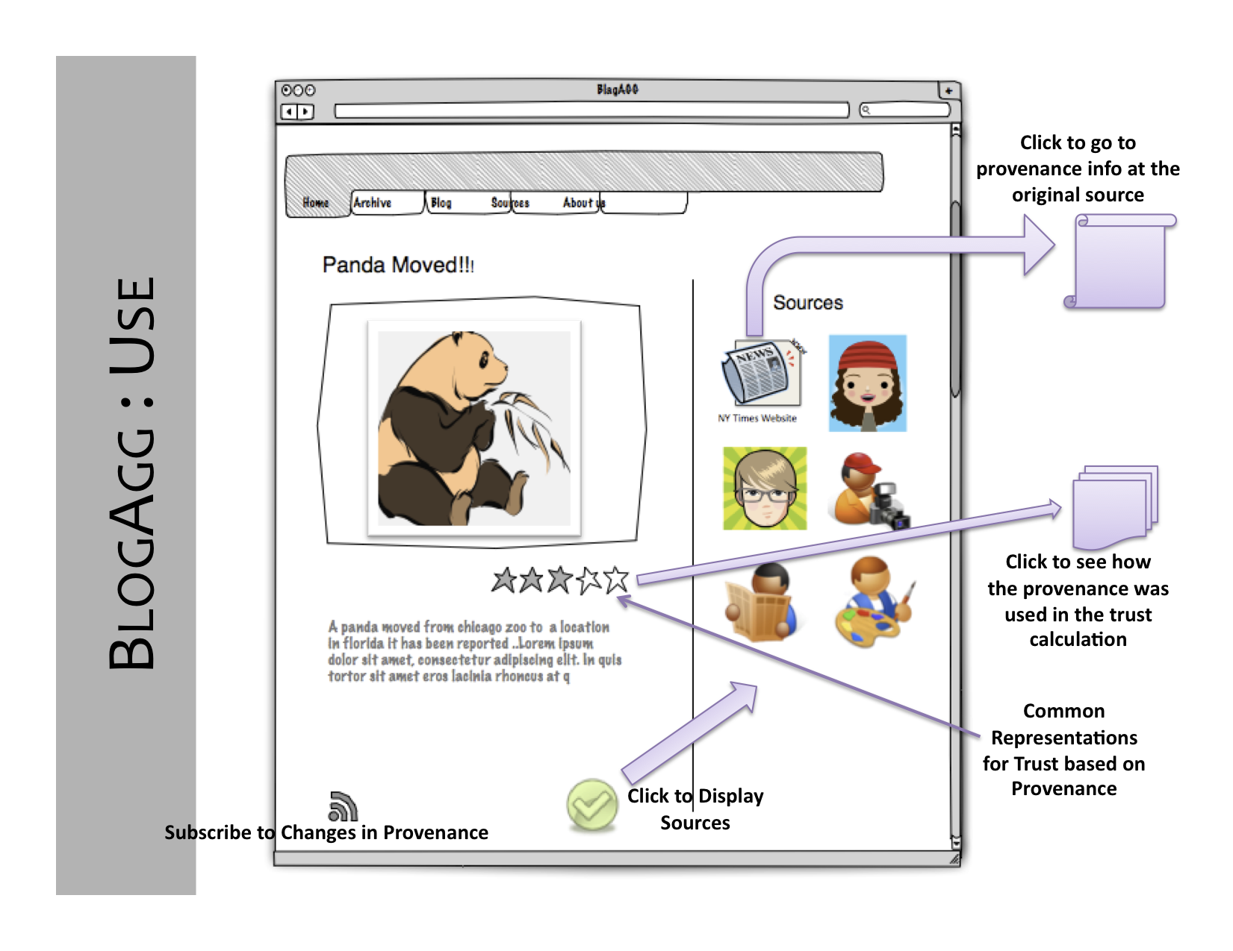

Slide 29
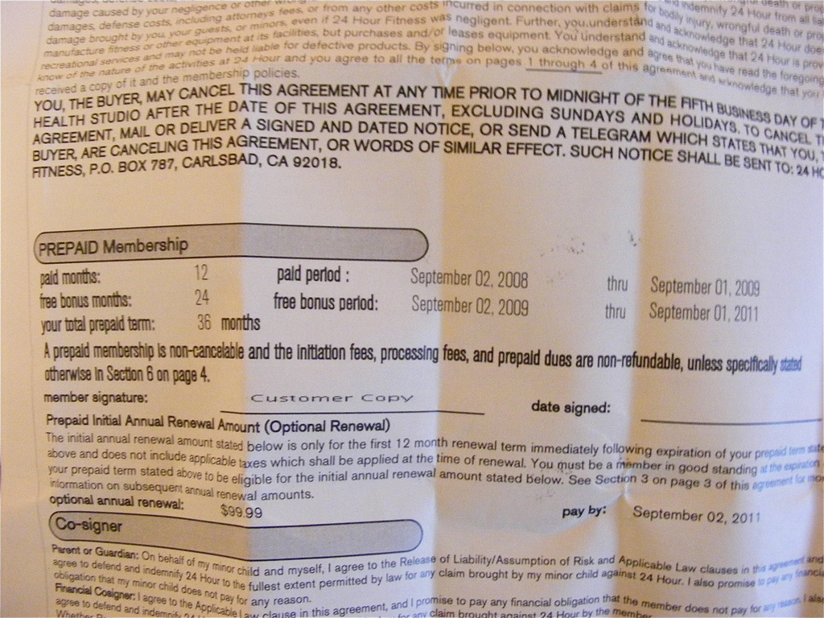
Scenario 2: Contract
http://www.flickr.com/photos/newbirth/2834643961/
Notes:
How many people have cell phones? How many people understand their cell phone contract?

Slide 30
Provenance Problems
BWF needs to prove that it performed correctly
BWF needs to show that it did not tamper with its reports
BWF needs to show that experts independently signed off on a product

Slide 31
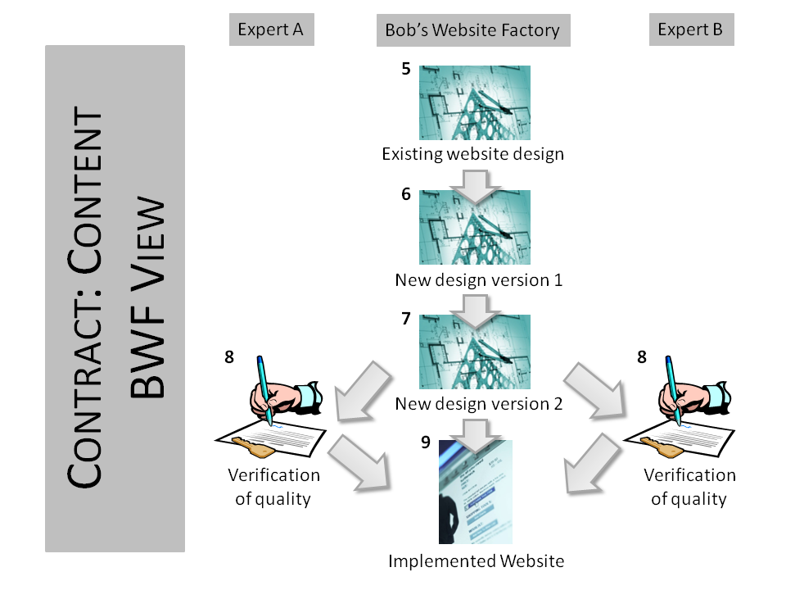

Slide 32
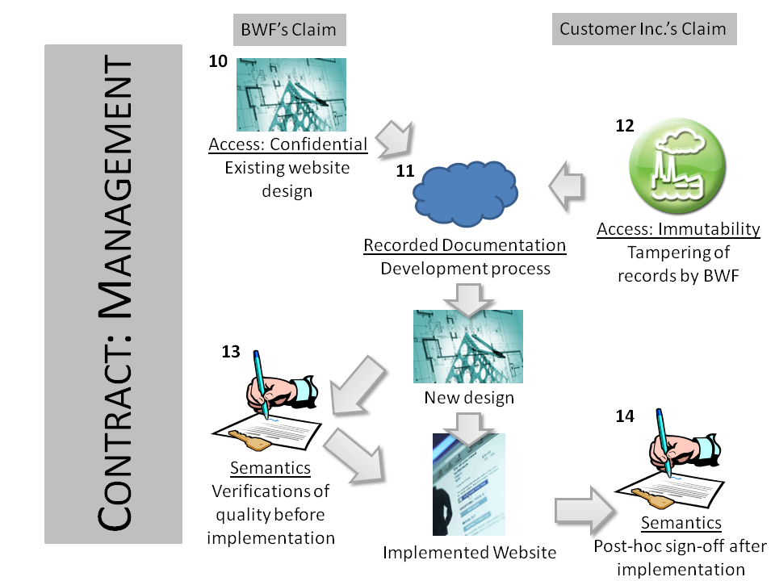

Slide 33
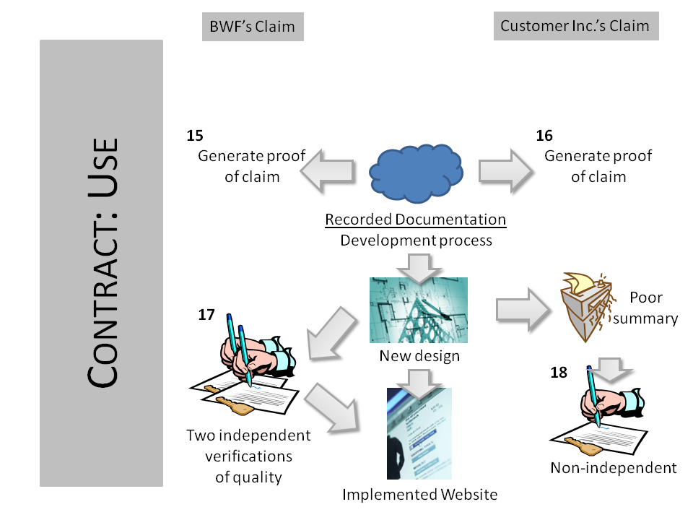

Slide 34
Revisiting Your Use Case
What dimensions need to be addressed in your use case?

Slide 35
Where does OPM help
Content
  Object
  Attribution
  Process
  Evolution
Management
  Publication
Use
  Understanding
  interoperability
Notes:
OPM can help us with many requirements for provenance.
**Use: Clearly, it helps us with interoperability by presenting a common standard. In understanding, there are beginning to be tools that take advantage of OPM to provide services. For example, the visualiztion tools in the OPM Toolbox. Or the OPM graph to taverna workflow system
**Management: In terms of publication, OPM provides a common way to expose our provenance data in either RDF or XML. Future updates will deal with APIs
** Content: OPM clearly helps us model processes, but us we’ve seen it can also be used for attribution (see agents controlling processes). In terms of objects in Opm we can easily identify artificats that we want to know the process, likewise we can see evolution as a form of process. VizTrails is able to represent their evolution of workflows using OPM
There are places where OPM isn’t “solution”, for example, in many uses for provenance (think trust assessment) OPM does not provide solutions but instead provides an infrastructure. Likewise, OPM is not meant to address tracking queries or dealing with scale these are “system” questions not interoperability or representation questions.
Discuss where and when they think they could apply their use cases and where OPM is helpful

