Slide 1
Open Provenance Model Tutorial
Session 6: Interoperability

Slide 2
Session 6: Aims
In this session, you will learn about:
Steps towards interoperability
Interoperability challenges
Next steps towards achieving interoperability

Slide 3
Session 6: Contents
The Open Provenance Vision (revisited)
PC3
PC4
Beyond Representation
Discussion

Slide 4
The Open Provenance Vision

Slide 5
Context: heterogeneous environments
Applications consist of compositions of loosely coupled, multi-institutional, heterogeneous components
How to trace the origin of data in such environments?

Slide 6
Provenance Across Applications
Application
Application
Application
Application
Application
How to understand the provenance of data products derived
by all these applications?

Slide 7
Provenance Across Applications
Application
Application
Application
Application
Application
Provenance Inter-Operability Layer
The Open Provenance Model (OPM)

Slide 8
Provenance Inter-Operability Layer

Slide 9
Open Provenance Vision
Open Provenance Vision is a vision of a set of architectural guidelines to support provenance inter-operability, consisting of
  controlled vocabulary,
  serialization formats and
  APIs
Open Provenance Vision allows provenance from individual systems to be expressed, connected in a coherent fashion, and queried seamlessly.

Slide 10
Export/Import Approach(PC3)
PS4
PS2
PS1
PS3
Provenance Inter-Operability Layer
N+1 conversions
Centralisation (scalability, security concerns)
Running queries is easy
Convert PSi content to OPM
Import OPM into PS
Run queries over PS
PS

Slide 11
Distributed Query Approach
PS4
PS2
PS1
PS3
Query API
Query API
Query API
Query API
Offer OPM based Query API
Federated query component
Query API not specified
N query APIs to implement
Running queries is challenging
Better scalability
Federated
Queries

Slide 12
Common Tools
Provenance Inter-Operability Layer
Visualisation
Reasoning
Conversion

Slide 13
Moving TOWARDS Interoperability (pc3)

Slide 14
Provenance Challenge 3
Identify weaknesses and strengths of the OPM specification
Encourage the development of concrete bindings for OPM in a variety of languages
Determine how well OPM can represent provenance for a variety of technologies (scientific workflow, databases, etc.)
Demonstrate that a complex data products provenance can be constructed from process assertions produced by multiple combinations of heterogeneous applications
Bring together the community to further discuss the interoperability of provenance systems.

Slide 15
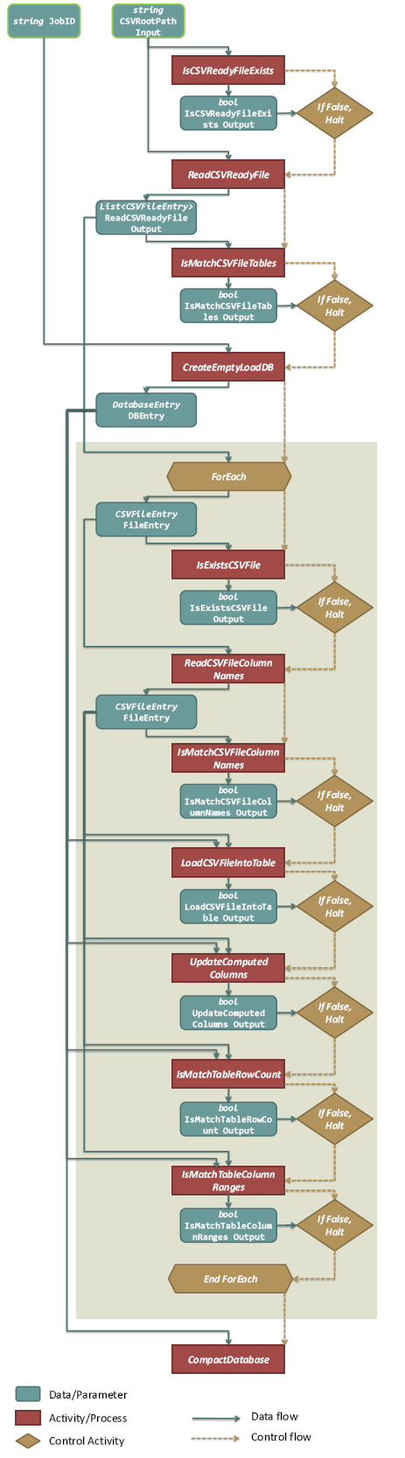
PC3 Workflow
The Pan-STARRS project is building and operating the next generation sky survey
The load workflow PC3, appearing at the handoff between the image pipeline and the object data management, ingests incoming CSV files into a SQL database.

Slide 16
PC3 Objectives
Implement Load workflow
Implement queries:
  For a given detection, which CSV files contributed to it?
  The user considers a table to contain values they do not expect. Was the range check (IsMatchTableColumnRanges) performed for this table?
Export provenance to OPM
Import other teams OPM outputs
Run queries over other teams’ provenance

Slide 17
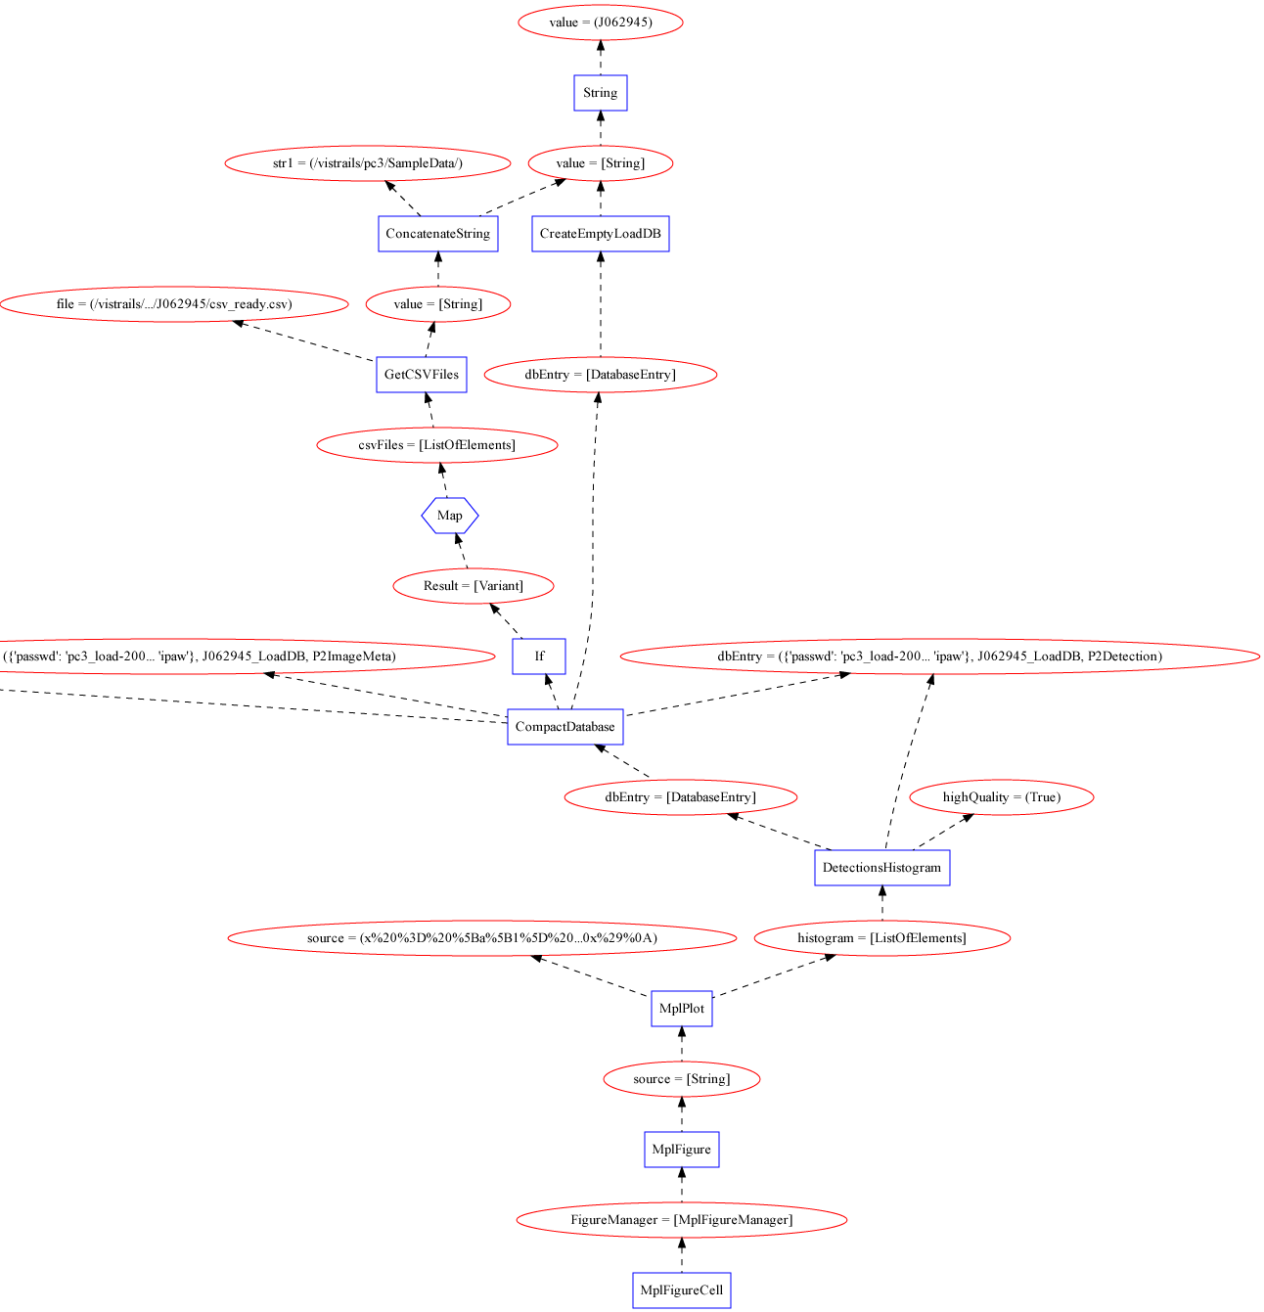
Good First Steps
Teams were able to read and write each others OPM Graphs
Most teams were able to perform queries on other OPM Graphs
Common Tools for provenance
  OPM Toolbox
  Tupelo API
  Graph visualizations

Slide 18
Challenges
Different structures for the same process
Difficult to determine where to start a provenance query
Lack of values or ability to look-up values made querying hard
Lack of types for filtering
Lack of consistency across time
  This is the same artifact but in a different state

Slide 19
Updates to OPM 1.1
Profiles to:
  Enable guidance about structures used
  Ability to look up particular values through vocabulary
Types
Persistent names

Slide 20
verifying interoperability (PC4)

Slide 21
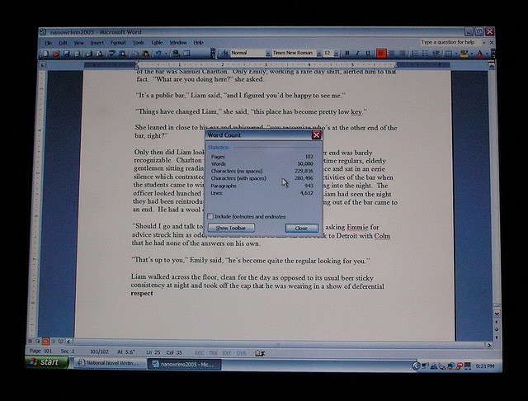
Are we closer?
Propose a final step (PC4)
Comprehensive test of interoperability using OPM
Like prior challenges but expanding the application
  Include users
  Include interactive applications
  Include decision points

Slide 22
Abstract Scenario
User Performs Action
Exchange between Services
User Decision Point
Running a service by others
Collections
Processing
Publish Data to Third Party
User DecisionPoint
Workflow
Workflow
Publish
Data at URL
Running Services with data others
Collaborative
Editing
Citing Data in Paper
Credentials
Discovery by Query
Social Collaboration
Notes:
The user decides on some input data produced by some service, this is sent to an independent service.
The output of that service informs a user decision regarding whether to go back and acquire new input data.
Once the user is happy with the output, they run a new process which is based on code provided by a friend. This produces a collection of data, which needs to be manipulated to generate a single file.
Using that single file, along with data provided by others, a service runs which produces a file X. File x is processed by a workflow which produces a visual image. The user then makes a decision based on that image. If the user is unhappy with the image, they repeat the production of File x. Once their happy, the publish the data to some third party. This third party makes the data available for public consumption at a URL. The user along with his colleagues edits a web page about the data. Once they come to agreement, they produce a paper, which cites the data. This is then published in a online repository requiring a set of credentials. This paper is then discovered by a query over the repository by User Y. User Y then discusses the paper using online collaboration technology (twitter). A User Q then asks about the provenance of something.

Slide 23
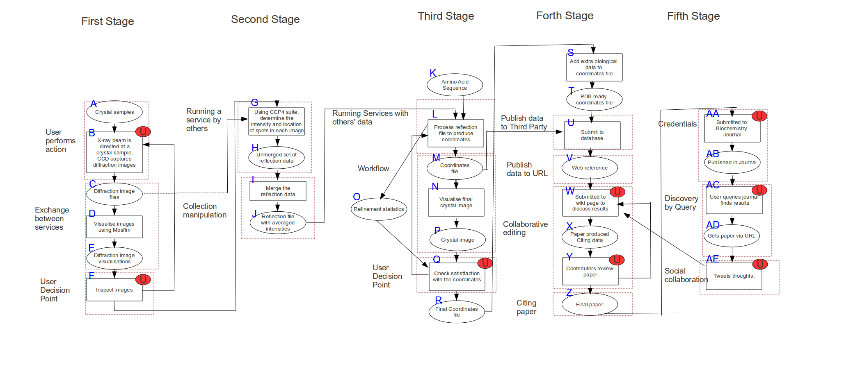
Crystallography Workflow

Slide 24
Provenance Questions
How many times has this data been cited in other reports?
For a given crystal, how often did a crystallographer reject and reproduce coordinates (the later stages of the experiment)?
  This is important because difficulty in obtaining an adequate crystal image can indicate that the original diffraction data was poor quality
The report has been published but how many times has it been edited before being published?

Slide 25
Additions
A common vocabulary
Integration points
  Allow different kinds of systems to “drop test” integration
Key: distinguish between provenance interoperability and other forms of interoperability
End-to-end provenance, not everything within the same system

Slide 26
Schedule
Abstract Scenario
Identify all the data flowing in the system with respect to the crystallography scenario (this can be mocked up) where possible we have example data: (August 30)
For each pattern of the process produce a mock-up of the opm graph with respect to the data in step 2 and make sure they stitch together (Nov 30)
Finalize queries with respect to scenario (Dec 15)
Import and implement queries over the mockup (Feb 28)
Generate and publish Provenance for each pattern (Feb 28)
Import and Implement Queries over the generated provenance (Mar 30)
Decide whether to do api compatibility
Prepare slides for challenge [Jun 1 - Jun 8]
PC4 Workshop June 10

Slide 27
Beyond representation

Slide 28
Vision
OPM provides a representation of provenance
But interoperability requires some more:
  Access provenance
  Given a document, what is its provenance
  Record provenance

Slide 29
Answering these questions
Simple solutions
Access: http get
Document: embedding information using RDFa [Groth2010-provenancejs]
Record: basic web service [prep2009]

Slide 30
Conclusion
We are close to interoperability in provenance systems
Community! Community! Community!
Please participate
Feedback, where do you need interop?

