Slide 1
Open Provenance Model Tutorial
Session 8: OPM Toolbox
Luc Moreau
L.Moreau@ecs.soton.ac.uk
University of Southampton

Slide 2
Session 8: Aims
In this session, you will learn about:
  How to install the OPM Toolbox
  How to write a Java program that generates an OPM graph
  How to serialize an OPM graph to XML or RDF
  How to convert and pretty print OPM graphs from the command line
  How to contribute to the OPM toolbox development

Slide 3
Session 8: Contents
Installation
Command line commands
Java programming
Open source development

Slide 4
OPM Toolbox

Slide 5
OPM Toolbox
A set of utilities to manipulate OPM graphs in Java
Binary distribution: toolbox-1.1.X-release.zip
Available from http://openprovenance.org/java/maven-releases/org/openprovenance/toolbox/
Unzip it!

Slide 6
Binary Release Contents
-rw-r--r--@ 1 lavm staff 1083 Sep 15 08:26 README-licenses.txt
-rw-r--r--@ 1 lavm staff 944 Sep 15 08:26 README-opm2dot.txt
-rw-r--r--@ 1 lavm staff 1070 Sep 15 08:26 README-opmconvert.txt
-rw-r--r--@ 1 lavm staff 640 Sep 15 08:26 README-opmrdf2xml.txt
-rw-r--r--@ 1 lavm staff 453 Sep 15 08:26 README-opmxml-validate.txt
-rw-r--r--@ 1 lavm staff 632 Sep 15 08:26 README-opmxml2rdf.txt
drwxr-xr-x 16 lavm staff 544 Sep 15 08:26 bin
drwxr-xr-x 9 lavm staff 306 Sep 15 08:26 examples
-rw-r--r--@ 1 lavm staff 1095 Sep 15 08:17 license.txt
drwxr-xr-x 22 lavm staff 748 Sep 15 08:26 repo

Slide 7
License
Copyright (@) 2008, 2009, 2010 University of Southampton
Permission is hereby granted, free of charge, to any person obtaining
a copy of this software and associated documentation files (the
"Software"), to deal in the Software without restriction, including
without limitation the rights to use, copy, modify, merge, publish,
distribute, sublicense, and/or sell copies of the Software, and to
permit persons to whom the Software is furnished to do so, subject to
the following conditions:
The above copyright notice and this permission notice shall be included
in all copies or substantial portions of the Software.
THE SOFTWARE IS PROVIDED "AS IS", WITHOUT WARRANTY OF ANY KIND,
EXPRESS OR IMPLIED, INCLUDING BUT NOT LIMITED TO THE WARRANTIES OF
MERCHANTABILITY, FITNESS FOR A PARTICULAR PURPOSE AND NONINFRINGEMENT.
IN NO EVENT SHALL THE AUTHORS OR COPYRIGHT HOLDERS BE LIABLE FOR ANY
CLAIM, DAMAGES OR OTHER LIABILITY, WHETHER IN AN ACTION OF CONTRACT,
TORT OR OTHERWISE, ARISING FROM, OUT OF OR IN CONNECTION WITH THE
SOFTWARE OR THE USE OR OTHER DEALINGS IN THE SOFTWARE.

Slide 8
Command Line executables

Slide 9
Converting to pdf
Graphviz must be installed, and dot executable in PATH
Usage:
opm2dot opmFile.xml out.dot out.pdf [configuration.xml]
Example:
cd opmToolbox
cat examples/bad-cake.xml
bin/opm2dot examples/bad-cake.xml cake.dot cake.pdf

Slide 10
Converting to RDF
Usage:
opmconvert -xml2rdf fileIn fileOut NS [yes]
opmconvert -xml2n3 fileIn fileOut NS [yes]
opmconvert -rdf2xml fileIn fileOut NS [gid]
Example:
cd opmToolbox
cat examples/bad-cake.xml
bin/opmconvert –xml2n3 examples/bad-cake.xml cake.n3 http://ex.com/
bin/opmconvert –xml2rdf examples/bad-cake.xml cake.rdf http://ex.com/
bin/opmconvert –rdf2xml examples/bad-cake.rdf foo.xml http://example.com/cake1/ gr_50

Slide 11
Writing a Java Program that creates an OPM GRAPH

Slide 12
A simple maven project
opmexample2.tar.gz from the tutorial distribution
tar xvf opmexample2.tar.gz
cd opmexample2
mvn clean install

Slide 13
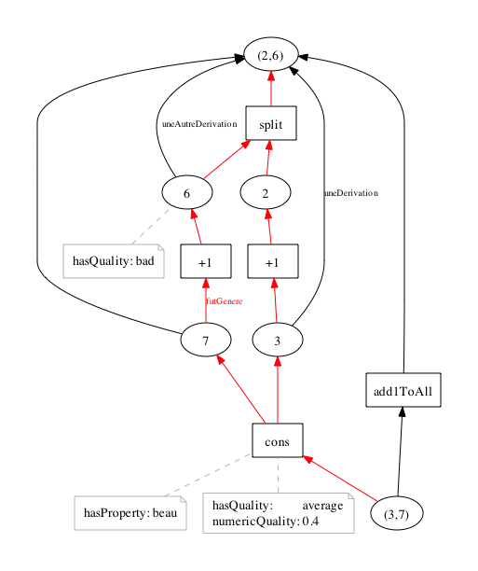
Resulting graph in target/

Slide 14
Maven Repository
<repositories>
<repository>
<id>opm</id>
<name>OPM releases Repository</name>
<url>http://openprovenance.org/java/maven-releases/</url>
</repository>
<repository>
<id>opm-snaphsot</id>
<name>OPM snapshot Repository</name>
<url>http://openprovenance.org/java/maven-snapshots/</url>
</repository>
</repositories>

Slide 15
Programming with the toolbox
Java model derived from XML Schema (JAXB)
Key class (and subclasses): OPMFactory
Contains factory methods for all OPM objects
Graph generator parameterized by factory
public OPMGraph getGraph(OPMFactory oFactory)
{
OPMGraph graph = ...;
return graph;
}
Full example in src/main/java/uk/ac/soton/ecs/opmdemo/MyGraph.java

Slide 16
Artifact/Process creation
Artifact a4=oFactory.newArtifact("a4",
orange,
"6");
Process p5=oFactory.newProcess("p5",
orange,
"http://process.org/cons");
Arguments are: node id, list of accounts, label for pretty-printing

Slide 17
Edge creation
Used u1=oFactory.newUsed(p1,
oFactory.newRole("in"),
a1,
green);
WasGeneratedBy wg1=oFactory.newWasGeneratedBy(a2,
oFactory.newRole("out"),
p1,
green);
WasDerivedFrom wdf1=oFactory.newWasDerivedFrom(a6,
a1,
green);
Arguments refer to previously created processes or artifacts

Slide 18
Graph creation
OPMGraph graph
=oFactory.newOPMGraph(green_orange,
new Overlaps[] {},
new Process[] {p1,p2,p3,p4,p5},
new Artifact[] {a1,a2,a3,a4,a5,a6},
new Agent[] {},
new Object[] {u1,u2,u3,u4,u5,u6,
wg1,wg2,wg3,wg4,wg5,
wdf1,wdf2, wdf3},
new Annotation[] {} );
Arguments refer to previously created nodes, edges, and accounts

Slide 19
Annotation creation
EmbeddedAnnotation ann
=oFactory.newEmbeddedAnnotation
("an15",
"http://property.org/hasQuality",
"average",
green);
oFactory.addAnnotation(a1,ann15);

Slide 20
Serialization
Get thread-safe serializer
Invoke serialization method with file, graph, and flag to pretty print
OPMGraph graph=new MyGraph().getGraph(oFactory);
OPMSerialiser serial
=OPMSerialiser.getThreadOPMSerialiser();
serial.serialiseOPMGraph(new File("target/example.xml"),
graph,
true);
Full code in src/test/java/uk/ac/soton/ecs/opmdemo/ExampleTest.java

Slide 21
Deserialization
Get thread-safe deserializer
Invoke deserialization method with file
OPMDeserialiser deserial
=OPMDeserialiser.getThreadOPMDeserialiser();
OPMGraph graph
=deserial.deserialiseOPMGraph(new File(”exmpl.xml"));

Slide 22
Conversion to dot/pdf
Create converter
Invoke conversion method (like command line)
OPMToDot toDot=new OPMToDot();
toDot.convert(graph,
"target/example.dot",
"target/example.pdf");

Slide 23
What about generation of RDF?
The Java data model is directly derived from the XML schema
JAXB converts from Java to XML and back
RDFOPMFactory is a subclass of OPMFactory, which also constructs an RDF representation in a Sesame model
Relies on Sesame’s elmo generating Java interfaces/classes from an OWL ontology
RDF representation compatible with OPM OWL ontology by construction!
Serializing is by dumping the RDF model

Slide 24
Conversion to RDF
Create the RDFOPMFactory:
oFactory=
new RdfOPMFactory(new RdfObjectFactory(manager,
TEST_NS));
Dump RDF (relies on helper class)
File file = new File("target/example.n3");
rHelper.dumpToRDF(file,
(SesameManager)manager,
RDFFormat.N3,
prefixes);
Full example in src/test/java/uk/ac/soton/ecs/opmdemo/RdfTest.java

Slide 25
Other stuff
IndexedOPMGraph: a class that allows incremental creation of OPM graph, indexing of its nodes, and easy traversal in a forward or backward manner
Basic support for graph normalization and comparison
Intended to support OPM graph algebra

Slide 26
Contributing to the OPM Toolbox

Slide 27
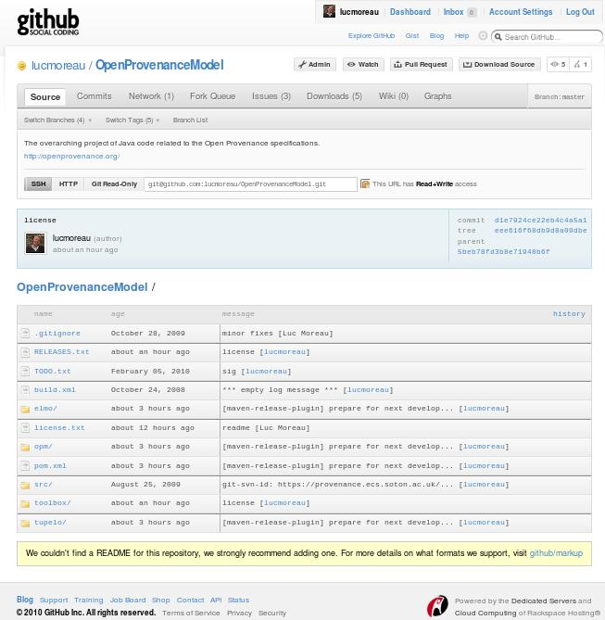
Source code on github

Slide 28
Get Involved
Source code:
  http://github.com/lucmoreau/OpenProvenanceModel
Currently three branches: master, opmsig, opmowl
Download, compile by a simple mvn clean install (note build relies on existence of unix executables such as sed in the path)
Fork in github.com and modify

Slide 29
Conclusion
OPM Toolbox intended to support useful and common functionality for manipulating OPM graphs
Community involvement would be desirable
Try and experiment with it!

